Slide 1



Hospital Management Database

Slide 2


Project Overview
The Hospital Management Database is designed to streamline various hospital operations. It will manage patients, doctors, and appointments, ensuring all related data is interconnected for a realistic and efficient workflow.
Patient & Appointment Management
Billing & Payments
Medication & Lab Tests
Monitor invoices and manage payment transactions seamlessly.
Oversee drug inventory and manage laboratory analysis results.
Efficiently track patient information and schedule appointments.

Slide 3
Objectives & Goals
The primary objectives of this project are to establish a centralized system for managing all critical hospital data, from patient records to financial transactions and inventory.
1
Record Management
2
Staff Administration
Register and manage patients, appointments, invoices, and drug prescriptions.
Handle information for doctors and other hospital staff.
3
Inventory Control
4
Reporting & Analytics
Manage medical supplies, medicines, and laboratory analyses.
Generate comprehensive reports for management and data analysis.

Slide 4
Requirements
The system's success hinges on meeting both functional and non-functional requirements, ensuring it is both comprehensive in features and robust in performance.
Functional Requirements
Non-Functional Requirements
Patient, doctor, and staff registration and management.
High performance for database queries.
Data integrity and consistency.
Appointment and medical prescription management.
Ease of data entry, including bulk CSV imports.
Invoice and payment management.
Inventory tracking and laboratory analysis follow-up.

Slide 5
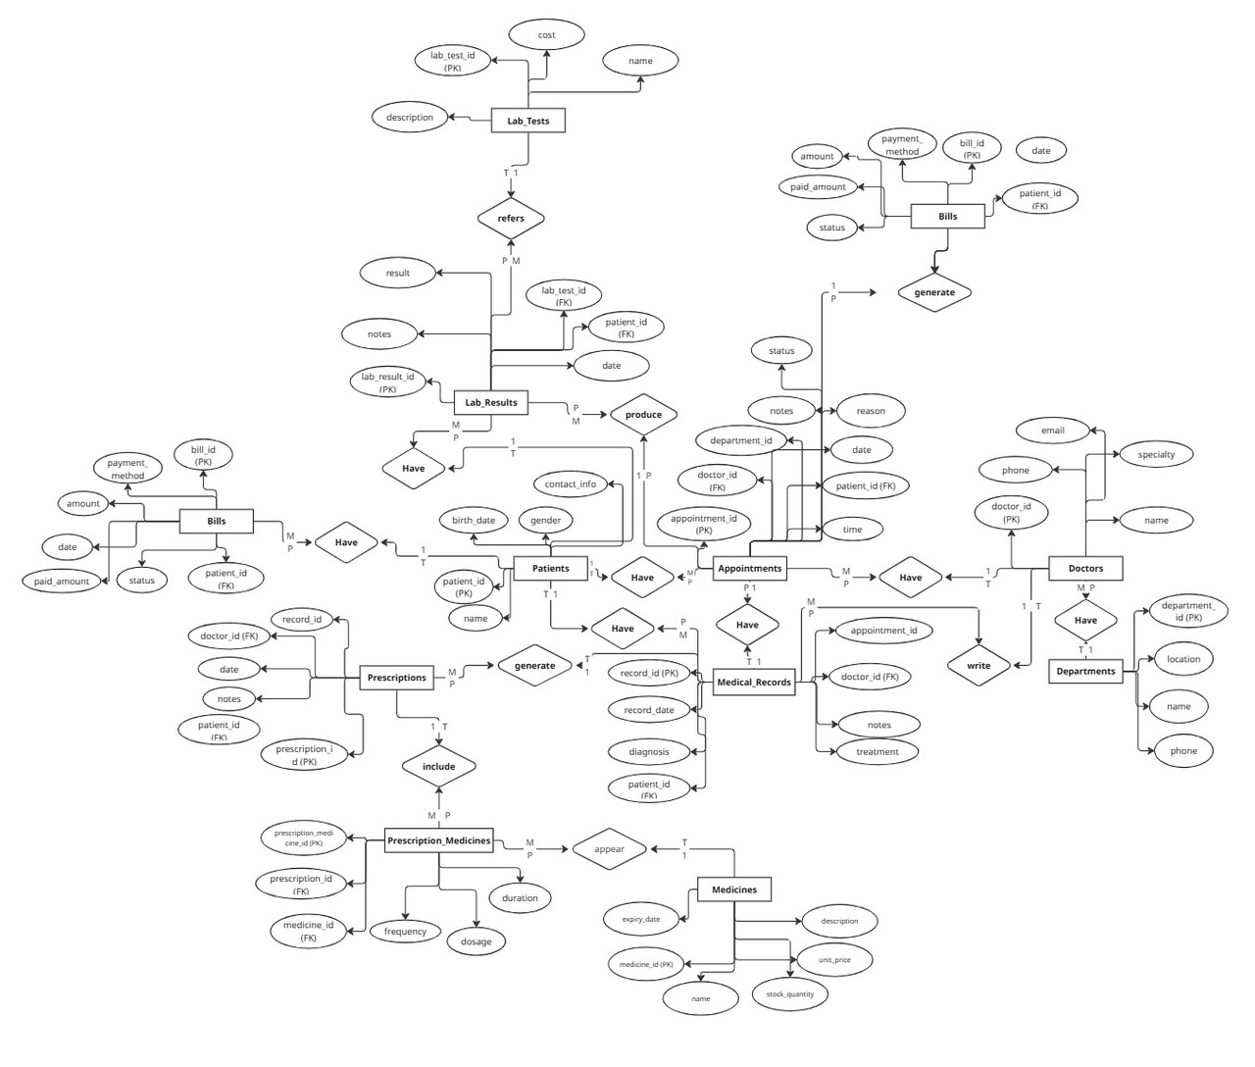
Entity-Relationship Diagram (ERD)
The ERD visually represents the structure of the database, highlighting the relationships between key entities. This diagram is crucial for understanding the database schema.

Slide 6
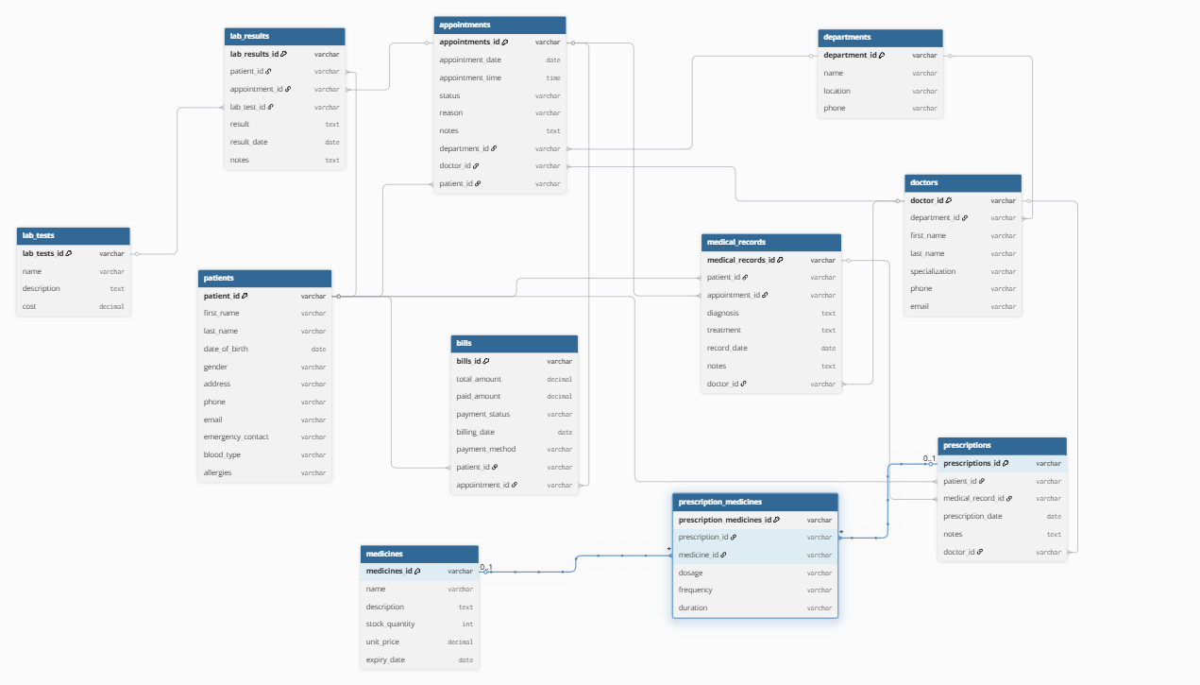
Mapping Relationships
Understanding the relationships between different tables is fundamental for a well-structured and efficient database. These mappings ensure data consistency and enable complex queries.

Slide 7
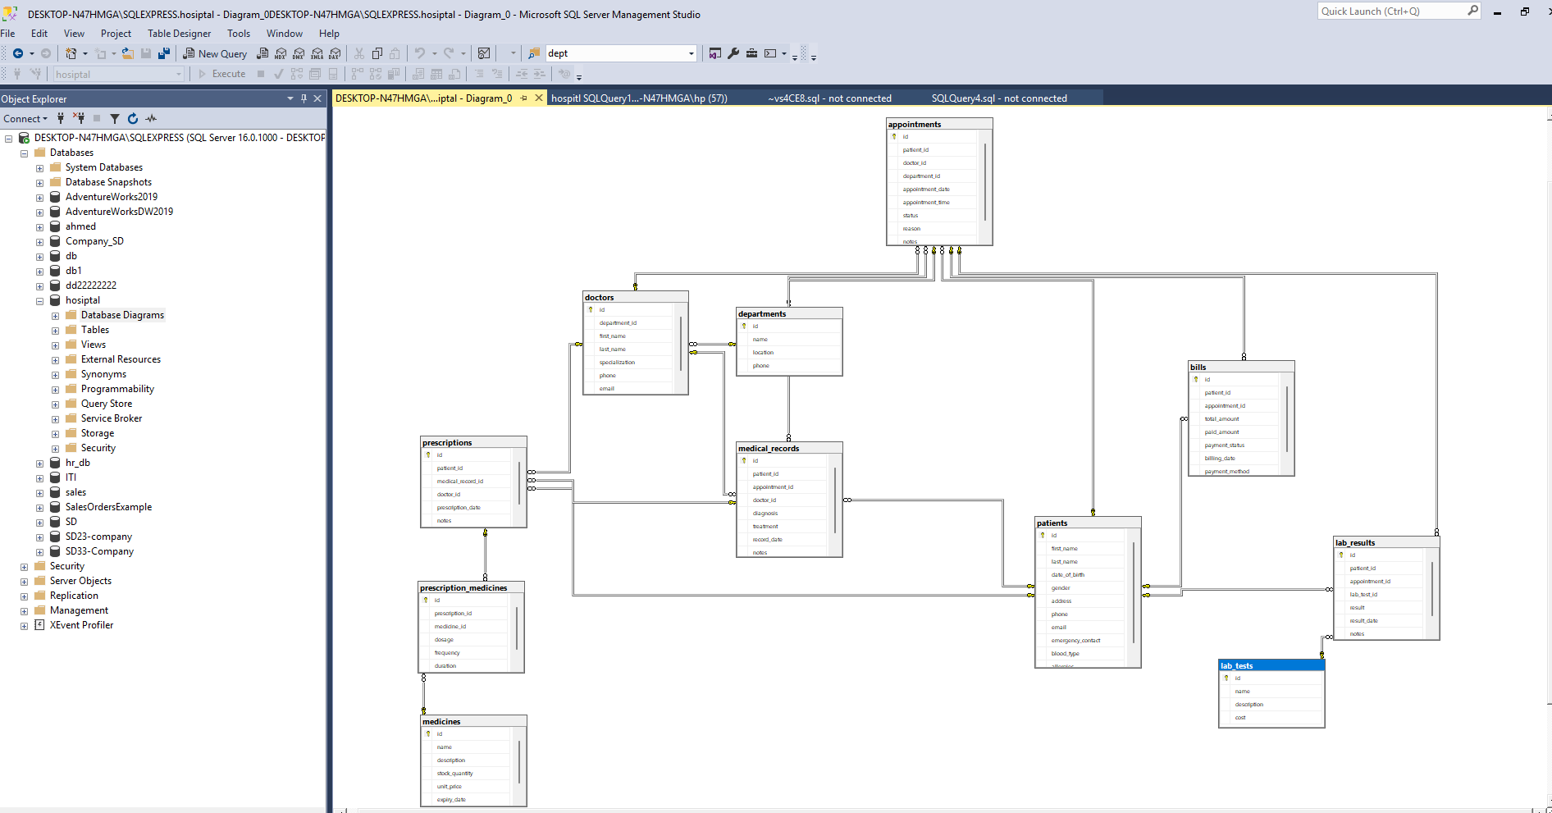
Database Implementation
The logical ERD is translated into a physical SQL schema, forming a normalized database designed to minimize redundancy and ensure data consistency. This foundation is critical for robust operations.

Slide 8
Table Operations
Table operations involve the Data Definition Language (DDL) commands used to manage the structure of tables within a database.
CREATE
Used to modify the structure of an existing table, such as adding, deleting, or modifying.
Used to create new tables in the database.
ALTER
DROP
Used to remove all records from a table, but keeps the table structure intact.
Used to delete an existing table from the database.
TRUNCATE
Data Manipulation (DML)
Data Manipulation Language (DML) commands are used for managing data within schema objects.
SELECT Queries
INSERT Operations
Used to retrieve data from one or more tables.
Used to add new rows of data into a table.
UPDATE Operations
DELETE Operations
Used to modify existing data within a table.
Used to remove rows of data from a table.

Slide 9
Filtering & Conditions: Essential Clauses
Filtering and conditions are crucial for retrieving specific data based on defined criteria.
WHERE Clause: Filters records based on specified conditions.
NOT Operator: Negates a condition.
IS NULL Operator: Tests for empty values.
HAVING Clause: Filters groups based on specified conditions.
BETWEEN Operator: Selects values within a given range.
AND Operator / OR Operator / Logical Operators: Combine multiple conditions.
ALL / ANY Operators: Used with subqueries to compare a value to every value or any value in a list.
LIKE Operator: Searches for a specified pattern in a column.
EXISTS Operator: Tests for the existence of any record in a subquery.
IN Operator: Specifies multiple possible values for a column.

Slide 10
Functions: Enhancing Data Manipulation
Sorting & Limiting Data
1
ORDER BY Clause
4
DISTINCT Clause
SQL functions perform calculations on data, modify data, or format output.
2
GROUP BY Clause
5
FETCH
3
LIMIT Clause
6
Aliases
Aggregate Functions
Perform calculations on a set of rows and return a single summary value (e.g., COUNT, SUM, AVG, MAX, MIN).
Set Operations
Date Functions
UNION: Combines the result sets of two or more SELECT statements and removes duplicate rows.
Manipulate and format date and time values (e.g., GETDATE, DATEDIFF, DATEADD).
UNION ALL: Combines the result sets of two or more SELECT statements and includes all duplicate rows.
String Functions
EXCEPT Operators: Returns all rows that are in the first SELECT statement but not in the second.
Manipulate and format character string data (e.g., CONCAT, SUBSTRING, LENGTH, UPPER, LOWER).

Slide 11



Advanced Concepts
JOINs
Views
Subqueries
JOINs are used to combine rows from two or more tables based on a related column between them.
Views
Subqueries
A virtual table based on the result-set of an SQL statement. A view contains rows and columns, just like a real table. The fields in a view are fields from one or more real tables in the database.
A query nested inside another SQL query. A subquery can be used in various clauses like SELECT, FROM, WHERE, and HAVING. It is also known as an inner query or inner select.
LEFT JOIN
LEFT ONLY
RIGHT ONLY
FULL JOIN
Backup and Restore
INNER JOIN
Left Table
Right Table
Backup: The process of creating a copy of your database to protect against data loss.
Restore: The process of recovering data from a backup copy to a database.

Slide 12

Conclusion & Next Steps
This document has provided a comprehensive overview of the Hospital Management Database project, from its conceptual design to implementation details and operational requirements.
Future Enhancements:
Integration with electronic health records (EHR) systems.
Advanced analytics for predictive healthcare insights.
Mobile application development for patient and doctor access.
The successful deployment of this database will significantly enhance the efficiency and effectiveness of hospital management, ultimately improving patient care.

